Slide 1

Computer price prediction app
Group 4

Slide 2
Business Problem
Business insight: Consumer often struggles with determining if a computer is overpriced, fairly-priced, underpriced which is never.
Problem definition: Given the electronical parameters about a computer can we predict its right price range
Significance: This tool tries to solve the problem by providing a transparent valuation where a buyer inputs desired spec and the model predicts a fair market price. Ensuring budget optimization and preventing overpriced purchases.
Evaluation: Our Hope is to minimize size and distribution of prediction errors as possible as it could get using regression models

Slide 3
Dataset overview
The dataset is coupled with 100,000 records with over 31 features.
These features ranges from the device type, brand, form, CPU, GPU information, memory & storage, display, power & connectivity and more.

Slide 4
Data cleaning
Thankfully there was no duplicates or null values. So, there was not that much of data cleaning. But I we dropped some columns that were a threat for our model training later like brand and CPU model.
Feature engineering
GPU model was also a feature that was a threat for our model due to its vast categorical value. But we couldn’t also drop it since price is generally affected by it tremendously. So before dropping it, we tried to extract generation and suffix from it. Which are processed features.
We also processed resolution into resolution pixels so the model can use it as a numerical value.

Slide 5
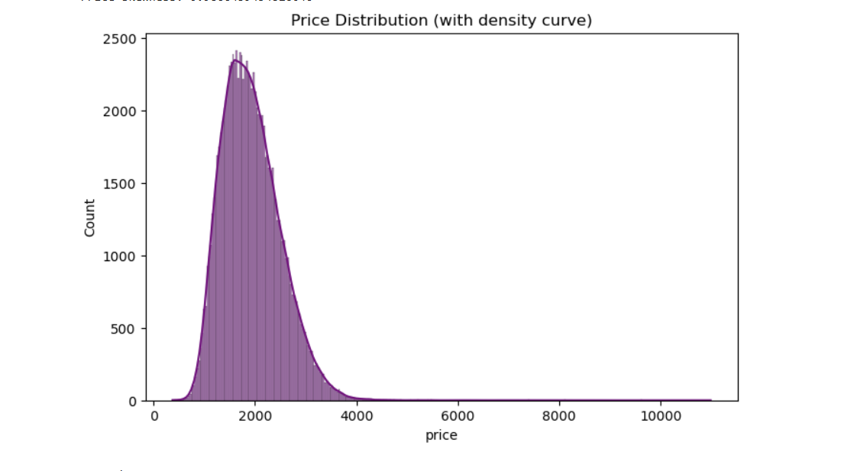
EDA
price is clearly right-skewed, peak around 1600-2000.
Skewness = 0.987 — moderate-to-strong right skew. This is our concrete justification to apply np.log1p(price) before training, particularly for the linear/distance-based models like Linear/Ridge/Lasso/SVR.
A strong right skew means we have a few extremely expensive items dragging the average up and many machine learning algorithms perform poorly when the target variable has a heavy right tail. it stabilizes variance, Normalizes the Error Distribution, Minimizes the Impact of Outliers.

Slide 6
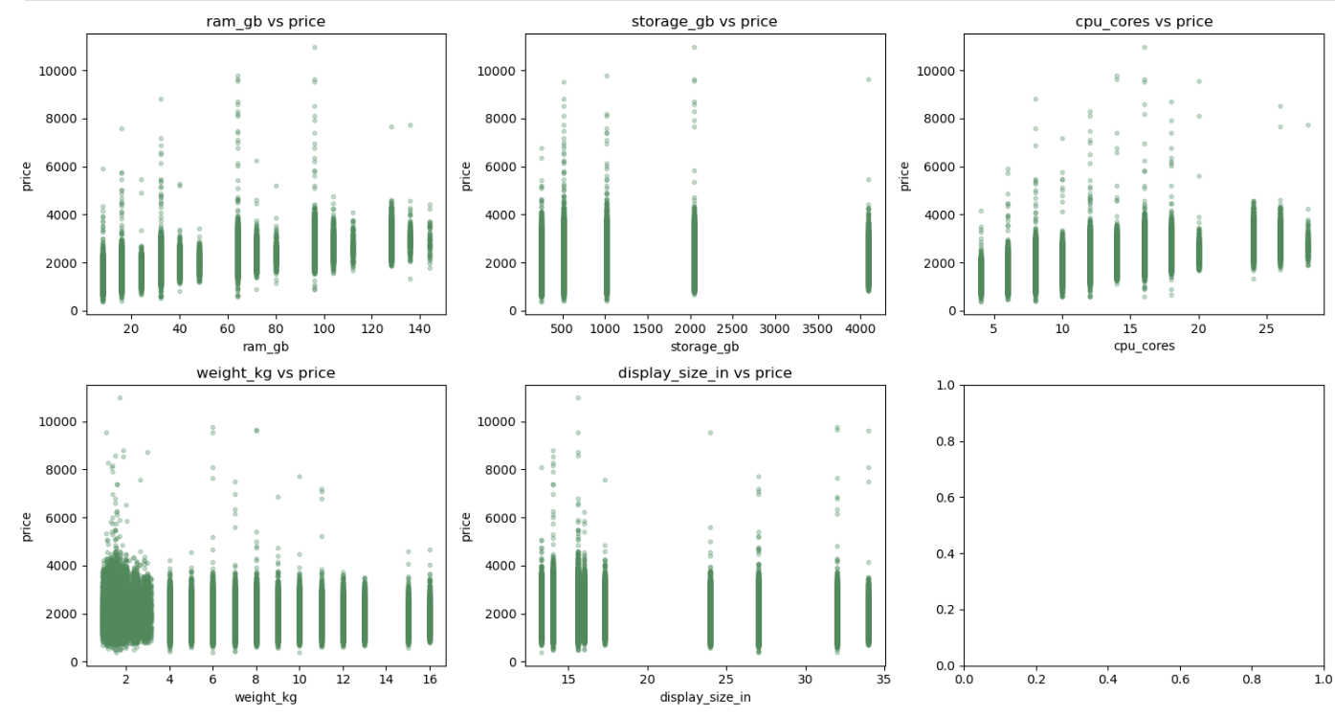
most of these features have a direct relationship with price weight_kg is heavily concentrated at the low end.

Slide 7
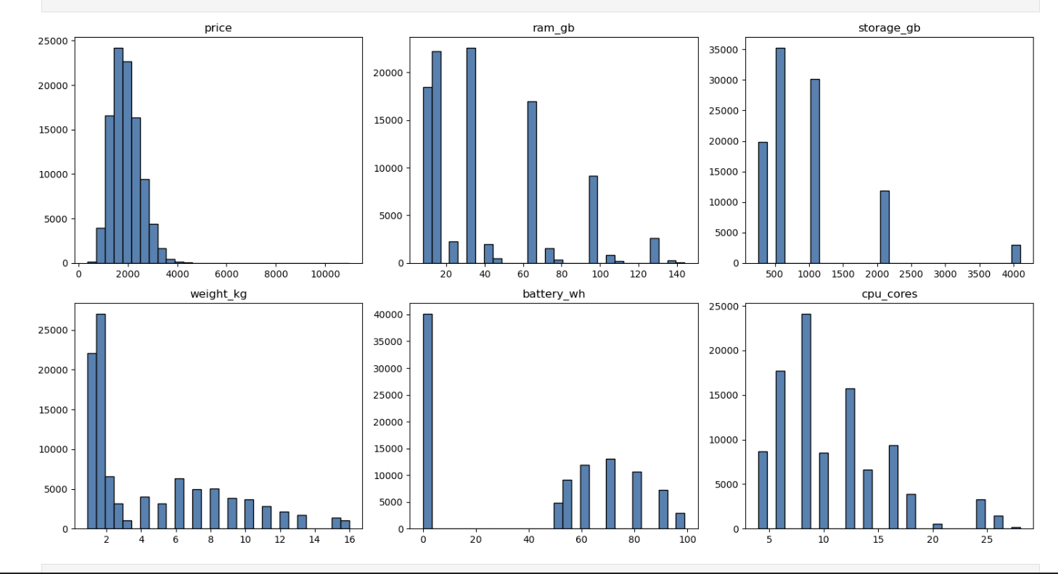
ram_gb and storage_gb, cpu_core have no smooth curves. they spike at standard size. battery_wh spikes at zero which implies our dataset mixes laptops and desktops.

Slide 8
Regression models
Eight regression algorithms were trained and compared on the same train/test split:
Linear Regression
Ridge Regression
Lasso Regression
Decision Tree Regressor
Random Forest Regressor
Gradient Boosting Regressor
Support Vector Regressor (SVR)
XGBoost Regressor

Slide 9
model evaluation
Rank | Model | MAE | MSE | RMSE | R²
1 | XGBoost | 141.131038 | 40,980.482014 | 202.436365 | 0.875897
2 | Ridge Regression | 148.060098 | 44,166.478736 | 210.158223 | 0.866249
3 | Linear Regression | 148.059822 | 44,166.541289 | 210.158372 | 0.866249
4 | Gradient Boosting | 152.028924 | 45,438.487508 | 213.163054 | 0.862397
5 | SVR | 153.272083 | 46,814.061350 | 216.365573 | 0.858231
6 | Random Forest | 157.074687 | 48,768.188587 | 220.835207 | 0.852313
7 | Lasso Regression | 205.610737 | 76,775.310496 | 277.083580 | 0.767498
8 | Decision Tree | 231.030550 | 113,671.150450 | 337.151524 | 0.655765
Each model was evaluated using MAE, MSE, RMSE, and R² on a held-out test set.

Slide 10
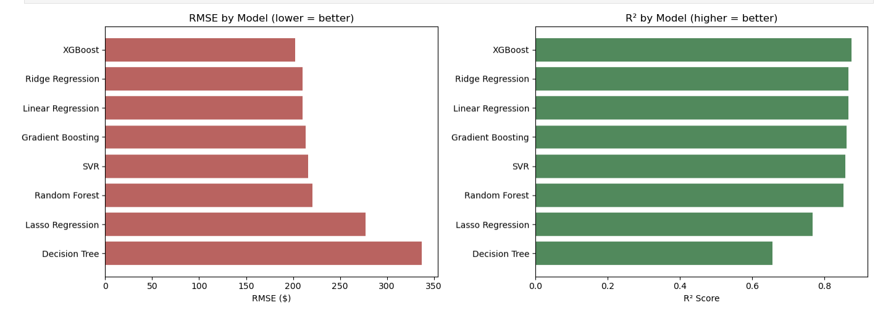
Model comparison
Based on the baseline performance the XGBoost Won
R2 = 0.876 means XGBoost explains about 87.6% of the variance in laptop prices using just the specs
MAE = 141 — on laptops averaging somewhere around 1,500-2,000 being off by ~141 on average is roughly a 7-9% error

Slide 11
Hyperparameter tuning
The top-performing models were then fine-tuned using RandomizedSearchCV (for the more expensive models) and GridSearchCV (for Ridge, which only has one key hyperparameter) to search for better hyperparameter settings
Rank | Model | MAE | MSE | RMSE | R²
1 | XGBoost (Tuned) | 137.583199 | 38,867.529025 | 197.148495 | 0.882296
2 | Gradient Boosting (Tuned) | 137.973205 | 39,208.623430 | 198.011675 | 0.881263
3 | SVR (Tuned) | 144.927404 | 42,402.682522 | 205.919116 | 0.871590
4 | Ridge (Tuned) | 148.060098 | 44,166.478736 | 210.158223 | 0.866249

Slide 12
Con.
Model | Baseline R² | Tuned R² | Improvement
XGBoost | 0.8759 | 0.8823 | +0.0064
Gradient Boosting | 0.8624 | 0.8813 | +0.0189
SVR | 0.8582 | 0.8716 | +0.0134
Ridge | 0.8662 | 0.8662 | +0.0000 (no change)

Slide 13
Conclusion: Best model selection
Final Selected Model: XGBoost Regressor (Tuned)
Why XGBoost performed best:
Feature interactions — price likely depends on combinations of specs (e.g. high RAM only commands a premium when paired with a high-end CPU/GPU too). XGBoost builds trees that can naturally split on one feature conditioned on another
Boosting corrects errors sequentially — each new tree specifically targets the residual errors of the ensemble so far, which is why boosting methods (XGBoost, Gradient Boosting) outperformed both a single Decision Tree and Random Forest's simple averaging.
Hyperparameter tuning added a further, modest improvement — R² rose from 0.876 (baseline) to 0.882 (tuned), suggesting the default configuration was already fairly close to optimal for this dataset.

Slide 14
Final comparison
Rank | Model | Version | MAE | MSE | RMSE | R²
1 | XGBoost (Tuned) | Tuned | 137.583199 | 38,867.529025 | 197.148495 | 0.882296
2 | Gradient Boosting (Tuned) | Tuned | 137.973205 | 39,208.623430 | 198.011675 | 0.881263
3 | XGBoost | Baseline | 141.131038 | 40,980.482014 | 202.436365 | 0.875897
4 | SVR (Tuned) | Tuned | 144.927404 | 42,402.682522 | 205.919116 | 0.871590
5 | Ridge Regression | Baseline | 148.060098 | 44,166.478736 | 210.158223 | 0.866249
6 | Ridge (Tuned) | Tuned | 148.060098 | 44,166.478736 | 210.158223 | 0.866249
7 | Linear Regression | Baseline | 148.059822 | 44,166.541289 | 210.158372 | 0.866249
8 | Gradient Boosting | Baseline | 152.028924 | 45,438.487508 | 213.163054 | 0.862397
9 | SVR | Baseline | 153.272083 | 46,814.061350 | 216.365573 | 0.858231
10 | Random Forest | Baseline | 157.074687 | 48,768.188587 | 220.835207 | 0.852313
11 | Lasso Regression | Baseline | 205.610737 | 76,775.310496 | 277.083580 | 0.767498
12 | Decision Tree | Baseline | 231.030550 | 113,671.150450 | 337.151524 | 0.655765

Slide 15
Live prediction demo
https://pred-app-deployed-1.streamlit.app/

Slide 16
Challenges faced
A challenge worthy of mentioning was the struggle we had with trying to train some models. The training and tunning time was intense especially for SVR, gradient boosting.
Due to its poor scalability (training time scales roughly O(n²)–O(n³) with dataset size). So, what we did is we trained it on a random subsample of 8,000 rows (rather than the full 99,999).
While tunning hyperparameters we faced the same trouble with time when trying to tune gradient boosting. So we minimized the iteration to 10 and cv to 3.

Slide 17
Future improvements
Try out more models especially ensemble boosters like catboost, adaboost, lightgbm.
Prediction history
Personal touch(database integration, user authentication )

